Slide 1
KAVIDEEPA E
Final Project
3/21/2024 Annual Review

Slide 2
PROJECT TITLE
Seasonal Image Translation and Adaptation using CycleGAN
3/21/2024 Annual Review

Slide 3


AGENDA
Problem statement
project overview
the end users
solution and its value proposition
the wow in solution
modelling
result
3/21/2024 Annual Review

Slide 4

PROBLEM STATEMENT
Seasonal changes significantly impact the visual appearance of landscapes, architecture, and natural environments. Adapting images captured in one season to appear as if they were taken in another season is a challenging task, often requiring manual editing or complex image processing techniques.
3/21/2024 Annual Review

Slide 5

PROJECT OVERVIEW
Our project focuses on using CycleGAN, a variant of Generative Adversarial Networks (GANs), to automatically translate and adapt images from one season to another. This approach aims to streamline the process of seasonal image adaptation and provide a valuable tool for photographers, designers, and image editors.
3/21/2024 Annual Review

Slide 6

WHO ARE THE END USERS?
Photographers: Professionals and hobbyists looking to enhance or alter the seasonal appearance of their images.
Designers: Graphic designers and artists seeking to create seasonal-themed graphics and visual content.
Image Editing Software Developers: Companies developing image editing software looking to incorporate automated seasonal image adaptation features.
3/21/2024 Annual Review

Slide 7

YOUR SOLUTION AND ITS VALUE PROPOSITION
Our solution leverages the power of CycleGAN to perform unsupervised image translation between different seasons. This approach eliminates the need for manual editing and enables users to quickly and easily adapt images to suit their seasonal preferences or thematic requirements. The value proposition lies in its ability to save time and effort while providing high-quality, realistic results.
3/21/2024 Annual Review

Slide 8

THE WOW IN YOUR SOLUTION
Unlike traditional image editing methods, our solution offers a fully automated process for seasonal image adaptation. Users can simply input an image captured in one season and obtain a realistically adapted version for any other season, all within seconds.
3/21/2024 Annual Review

Slide 9
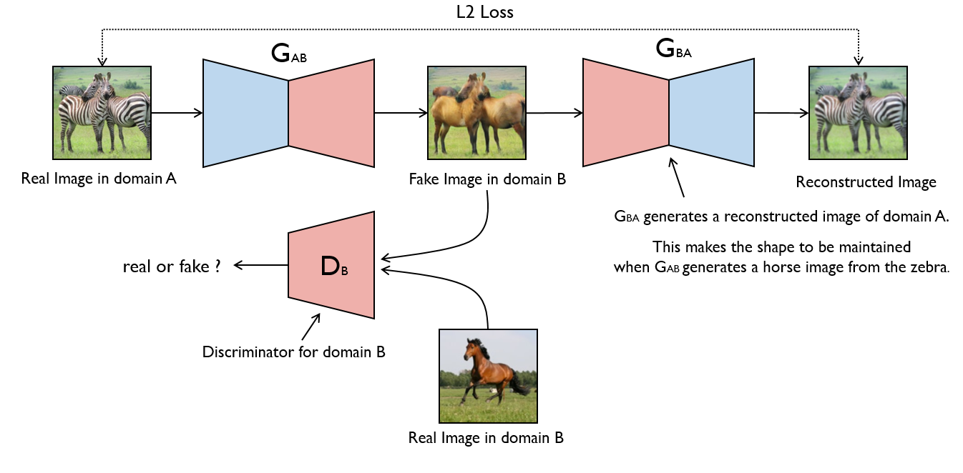
MODELLING
3/21/2024 Annual Review

Slide 10
RESULTS
Our preliminary results demonstrate the effectiveness of our CycleGAN model in translating images between different seasons. Quantitative metrics and qualitative evaluations show that our approach produces visually appealing results that closely resemble images captured in the target season.
Untitled32.ipynb - Colaboratory (google.com)
3/21/2024 Annual Review

